Slide 1
How to Build A Tiny URL Generator

Slide 2
Specifications
Create a Tiny URL Generator that has below features:
Users should be able to create a tiny URL for their URL.
Users should be able to use that URL to redirect to the actual link.

Slide 3
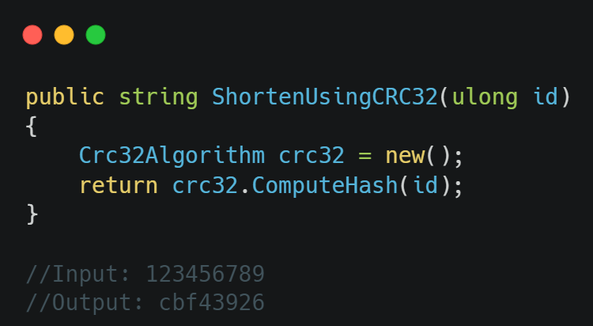
SIMPLEST Way
Use a Hashing Function like CRC32 to Generate a Tiny URL which generates a 8 character hash.

Slide 4
CRC32
LIGHT WEIGHT
It has really fast 🔥🚀
Algorithm
It uses a linear function to generate hash
Limitation
It can generate up to 4 Billion Unique Hashes
FIXED HASH SIZE
It only generates 8 character hashes

Slide 5
What IF We wanted a hash THAT is Dynamic AND CAN SCALE BEYOND 4 Billion?

Slide 6
Base62
Dynamic
Scalable
The value will grow in size with the input
A 7 digit Base62 hash can handle 3.5 Trillion URLs
Numbers Only
Predictable
It only works with a numeric value
It is easy to figure out next hash

Slide 7
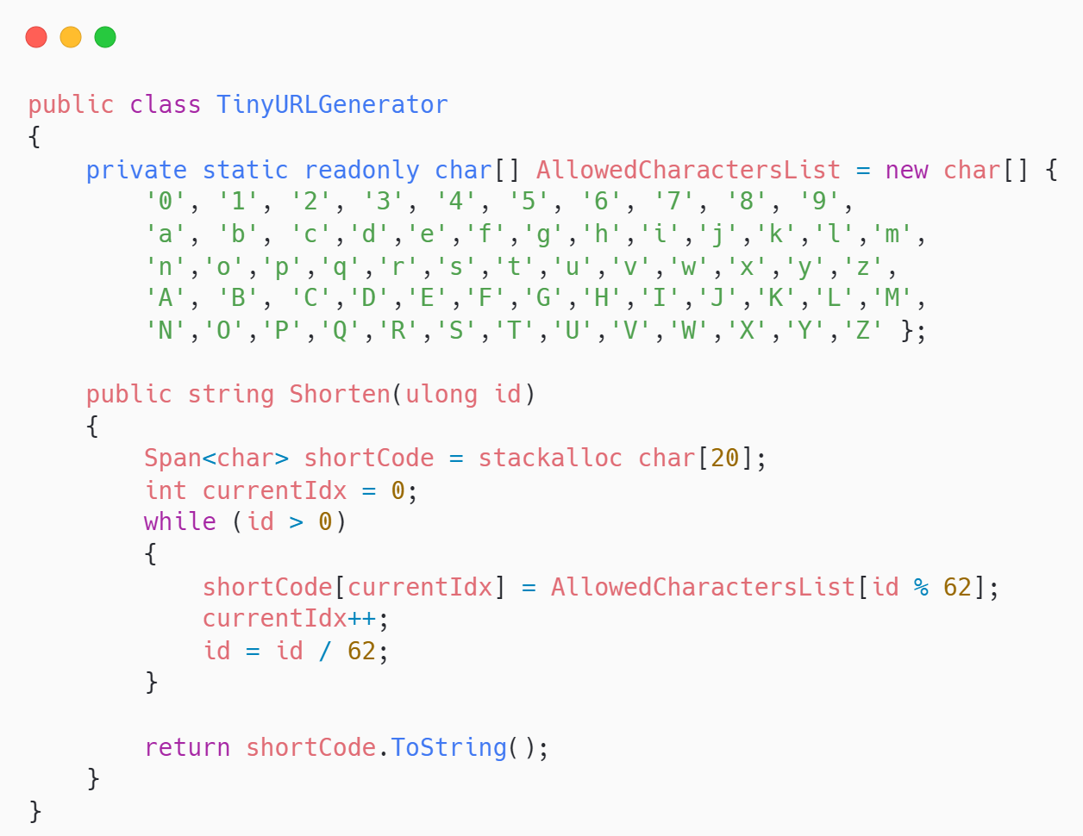
CORE Implementation

Slide 8
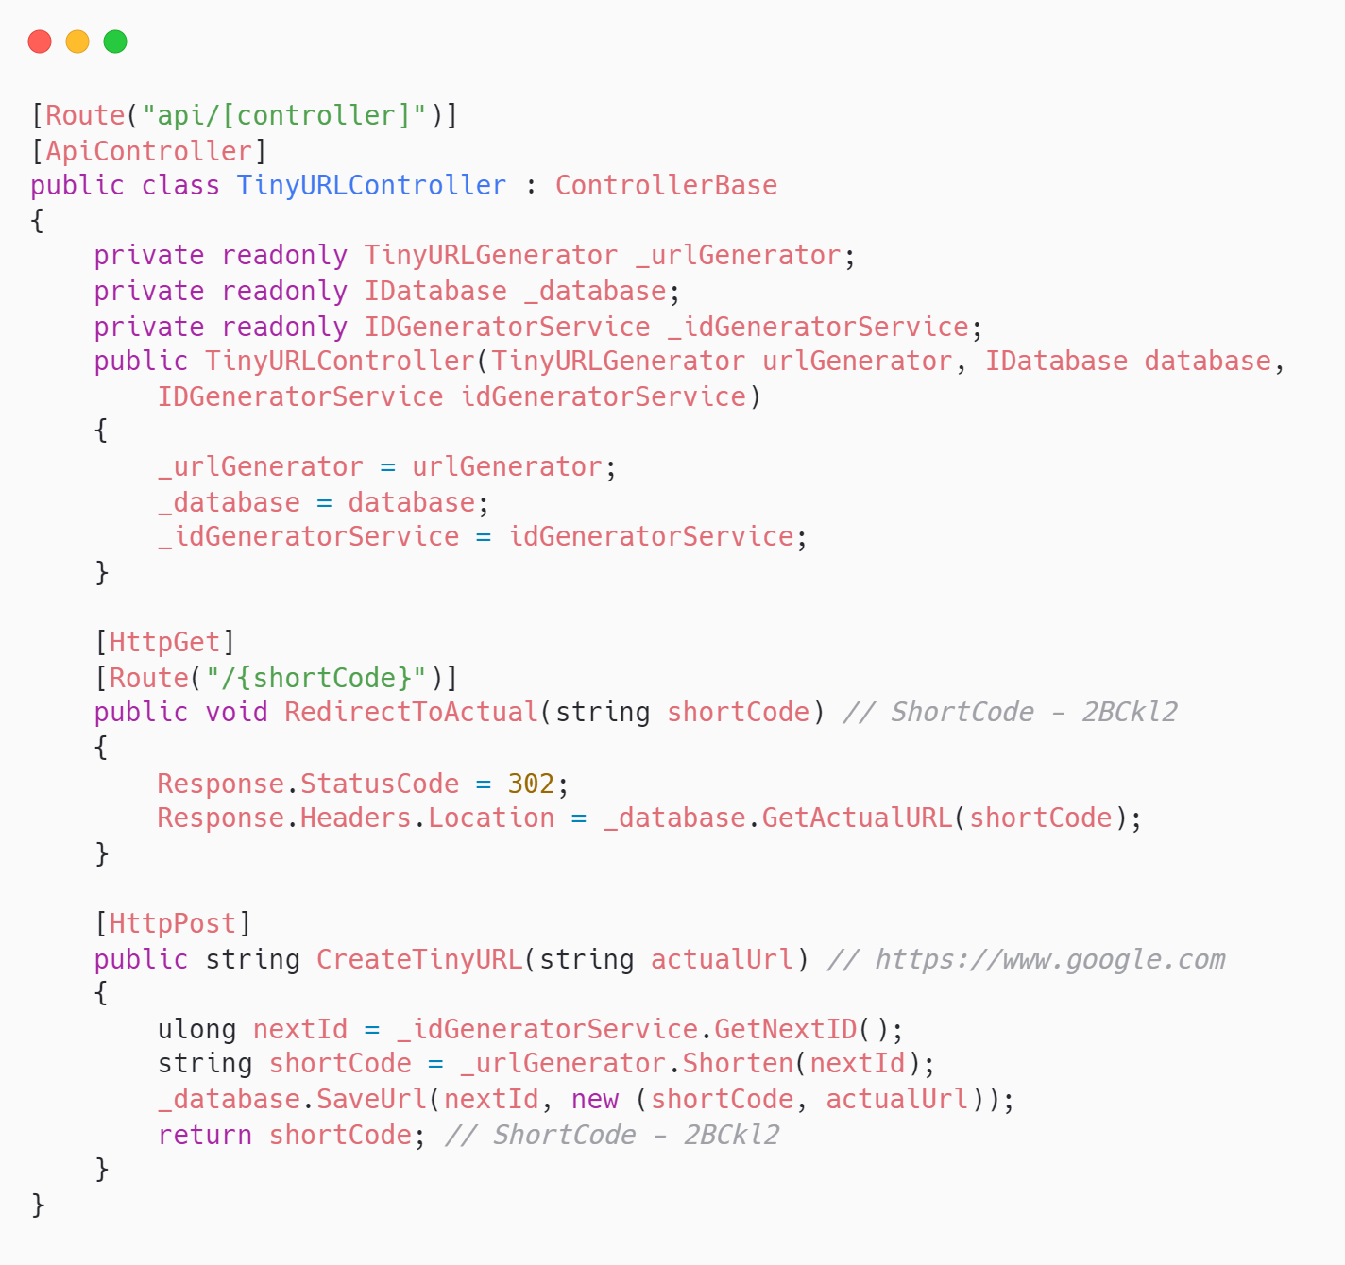
API Wrapper

Slide 9
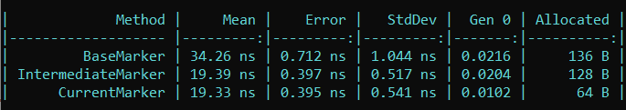
CORE PERFORMANCE
The current solution can generate ~55 million tiny URLs per second on a PC.
API PERFORMANCE
Assumtions:
Database Writeback Latency is around 20 ms
Database Read Latency is around 10 ms with
Server is in the same continent
Estimates (per server):
Write Performance is ~40 requests/second
Read Performance is ~200 requests/second

Slide 10
API PERFORMANCE SUCKS! What Next?

Slide 11
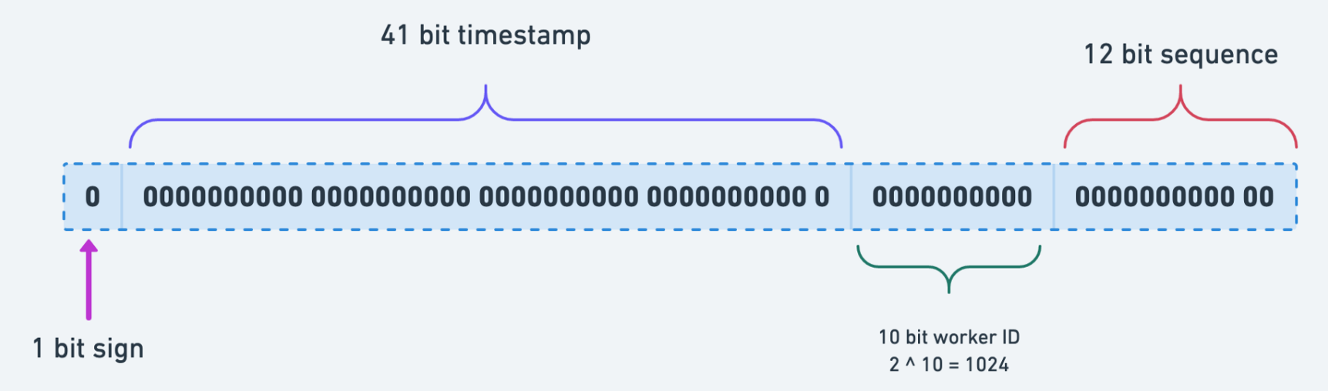
Lets add more SERVERS!
BUT…
How do we maintain uniqueness of IDs since now that we have multiple servers?
Twitter to the rescue
Twitter introduced the SnowFlake approach of Id generations. Where unique ids were generated based on timestamp, datacenter id, machine id and sequence number.
RESEARCH
There are several other ways one can generate Unique IDs:
Multi-master replication
Ticket Server

Slide 12
THINGS TO CONSIDER
DDOS
Database Scaling
Caching
Its probably a good idea to implement a rate limiter to prevent attackers from bombarding your website with post requests
It is probably a good idea to have database replication or sharding in place if you are serving a relatively large user base.
Caching is necessary to reduce read calls to the database. This helps in reducing DB load for read requests and reduces response times significantly.

Slide 13
SUMMARY
Designing a rate limiter is easy. The challenge is to scale it beyond a certain amount of users. You should always consider the possibility of failure and try to introduce fail safes to prevent a major downtime. Things like Rate Limiting, Caching and DB Scaling would go a long way.

Slide 14
Resources
Code
GitHub – https://github.com/sajagjain/TinyURL
PPT Author – Sajag Jain
LinkedIn - https://www.linkedin.com/in/sajagjain

